Slide 1
Standardized Test Scores and Poverty in the United States
Gwen Rathgeber
DSI-12-The Matt

Slide 2
Problem Statement
SAT and ACT scores are seen as an objective metric for student aptitude
These scores directly influence college admissions decisions
However, family wealth is known to affect test scores.
Can we see this pattern in state-level data?

Slide 3
Methodology
Source data
Clean and prepare data
Examine trends
Create visualizations
SAT/ACT
Census Poverty

Slide 4
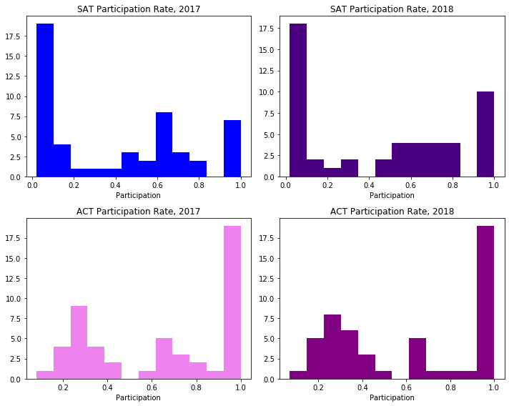
There are two
main groups
of states

Slide 5
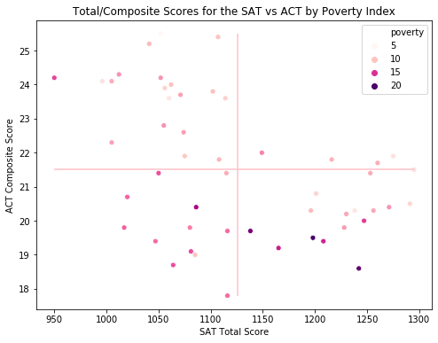
The Missing
Fourth Quarter

Slide 6
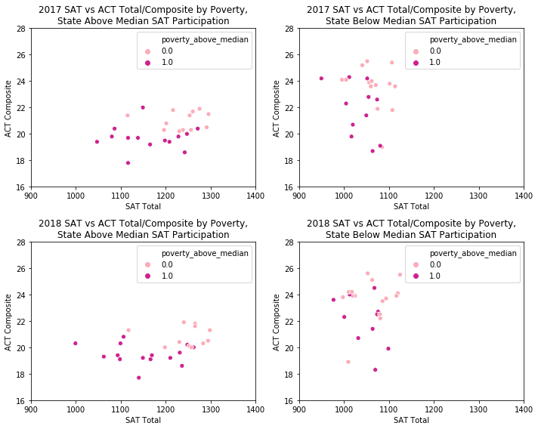
The Two Stories

Slide 7
Conclusions and Recommendations
SAT and ACT scores shouldn’t be considered objective without factoring in wealth
Cheaper access to test prep and equitable school funding could help equalize the US college admissions process
Room for modeling to put a number to these effects!

